Slide 1
Creating a Record Retention Schedule 5/2019
West-Central Africa Division Training
May 2019
Roy Kline, MHA
Assistant Director
Office of Archives, Statistics & Research
General Conference of Seventh-day Adventists
kliner@gc.adventist.org
(1) 301-680-5026

Slide 2
Hopefully You’re Somewhat Familiar With a Record Retention Schedule

Slide 3
What is a Record ?
A record is a document, data, or set of data that is created or received in the course of an organization’s business that meets
five characteristics:

Slide 4
Characteristics of a Record
Content - the text, data, metadata, symbols, numerals, images, and/or sounds that make up the record’s substance;
Structure - the physicality and internal organization of the Content;
Fixity - the quality of the Content being stable and resisting change;
Context - the organizational, functional, and operational circumstances surrounding a record’s creation, receipt, storage, or use; and
Evidence – the maintenance of an organization’s activity(s)

Slide 5
Records Life Cycle
Archive
Research
Historic Preservation
Records Center
Storage
Disposition
Active Records
Creation
Distribution

Slide 6
What is a Record Retention Schedule?
Essentially it’s a document that lists those records that are in the organization and how long the organization needs to keep each type of record
Employees come and go but your Record Retention Schedule functions as a set of written instructions so that all of your employees know – at all times – exactly what records to keep, how long to keep them for, and when to destroy them

Slide 7
Record Retention Objectives
Prompt disposal of records whose retention period has ended
Storage of records which must be temporarily retained after they are no longer needed in current business
Preservation of records which are of long-term value

Slide 8
How do you handle your Record Retention ?

Slide 9
Retention Issues To Consider
1) Time
2) Media
3) Storage
4) Vital Records
5) Budget

Slide 10
Retention Issues (1 of 5)
Time:
Permanent or indefinite: If it is already decided that a particular set of records is to be kept indefinitely, the only other consideration for that set of records is how and where to store them.
Regulations: Applicable National, State/Local and even Municipal regulations establish the minimum time period a set of records MUST be kept.
Business Use: The business use that a record supports often determines where and for how long a record is kept.

Slide 11
Retention Issues (2 of 5)
Media:
Composition: The media on which the record is stored or produced is NOT a determining factor in deciding how long a record is to be kept (i.e., electronic correspondence and paper correspondence would have the exact same retention period).
Legal holds: Any records that have been subpoenaed; any records for which there is knowledge of impending litigation; or any records for which there is even reasonable suspicion that there will be litigation must NOT be destroyed. After the close of litigation records may be re-evaluated for purposes of retention.

Slide 12
Retention Issues (3 of 5)
Storage:
Frequency of retrieval: Frequent retrieval and refiling would call for keeping files close by or even kept in a digital format online.
Need for wide distribution: Records can be distributed quickly and economically when they are kept in a digital format.
Retention time: Longer retention requirements are better met by stable media less dependent on technology for readability. Retention periods longer than 10 years will require a migration strategy for digital records.

Slide 13
Retention Issues (4 of 5)
Vital Records:
Mission critical records without which the organization could not function (about 2% to 7% of organizational records)
Examples: charters, minutes, service records, property records, insurance policies, donor lists, and accounts receivable
Protection:
Redundancy: Keeping copies of vital records in a safe off-site location.
Vaulting: Keeping vital records in a location that is safe from physical hazards such as fire, water, mold and theft.

Slide 14
Retention Issues (5 of 5)
Budget
Paper: Costs: printing, distribution, retrieval time, and storage space Note: In some cases it may cost less to store paper in commercial storage than to microfilm it.
Microfilm: Costs: document preparation, filming, distribution, retrieval, reader/printer, climate controlled storage.
Electronic: Costs: document preparation, quality control, indexing, computer workstation & server, periodic record migration.

Slide 15
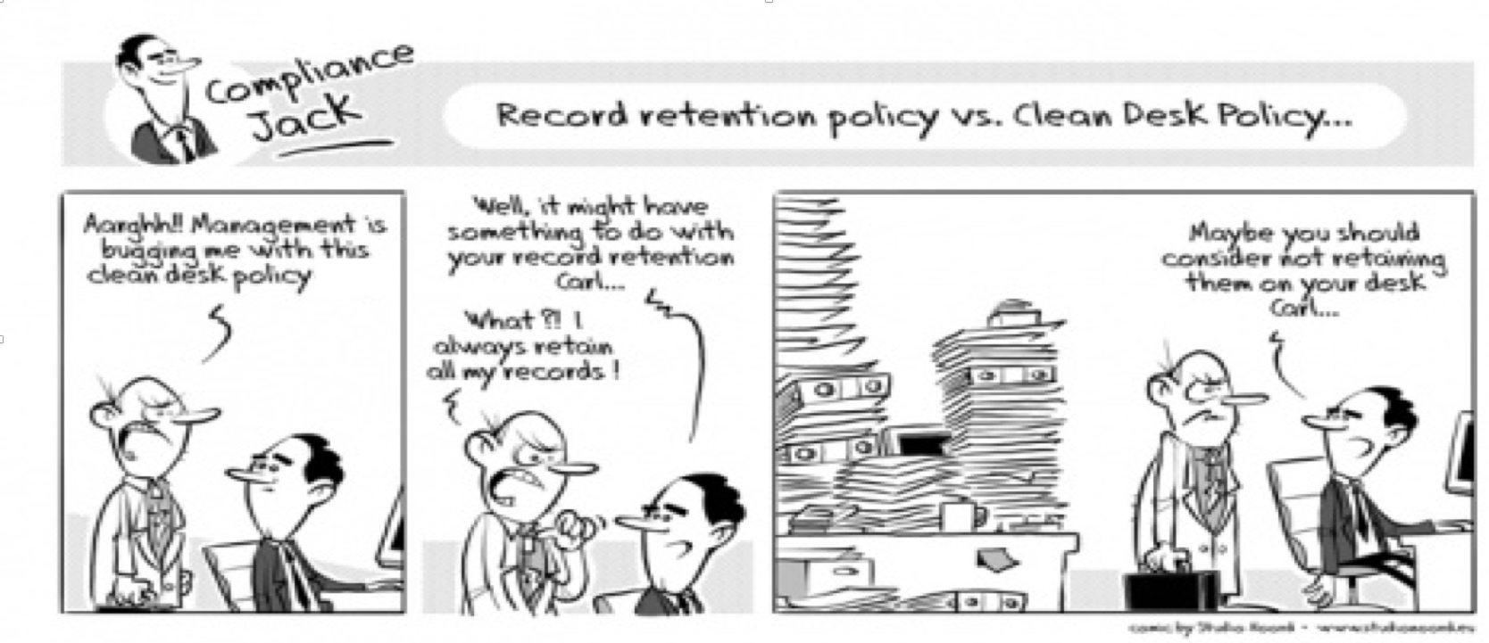
How do you see Record Retention?
Record Retention may not be much fun, but it can improve your quality of
life by freeing up filing space, making records-storage and record-retrieval
more efficient, and minimizing litigation risks for the organization.

Slide 16
Questions so far?

Slide 17
Path to Creating a Retention Schedule
Creating a statement that declares the scope and purpose of your retention schedule.
Having the statement reviewed and endorsed by top management.
Establishing the procedures for creating the retention schedule.
Documenting the process of creating the retention schedule.
Retaining the documentation as an audit trail for establishing and following the retention schedule.

Slide 18
Procedures for Creating a Retention Schedule (1 of 2)
Contact your records manager (designate someone if necessary) to coordinate the process
Inventory all current records maintained in the office to which (including all media types) the retention schedule is to apply
Create a master list of record types and draft a preliminary retention schedule
Determine retention periods on the basis of legal, administrative, and historical value

Slide 19
Procedures for Creating a Retention Schedule (2 of 2)
Obtain approval from relevant areas with oversight responsibility (i.e. IT, finance, or legal)
Publish and follow the retention schedule
Review the retention schedule at regular intervals (i.e. annually, biannually, etc. )

Slide 20
Sample Retention Schedule Timetable
Inventory forms collated and information put into a draft records retention schedule by Archives. (To be completed in 2 weeks)
Draft retention schedule reviewed and edited by department management. (To be completed in 1 week)
Department management to meet with Archives to put retention schedule into final form, pending review by Office of General Counsel. (approximately 1 hour)
On approval of Legal the retention schedule becomes official until there is a further revision.

Slide 21
You need a Retention Schedule regardless of where you store your records

Slide 22
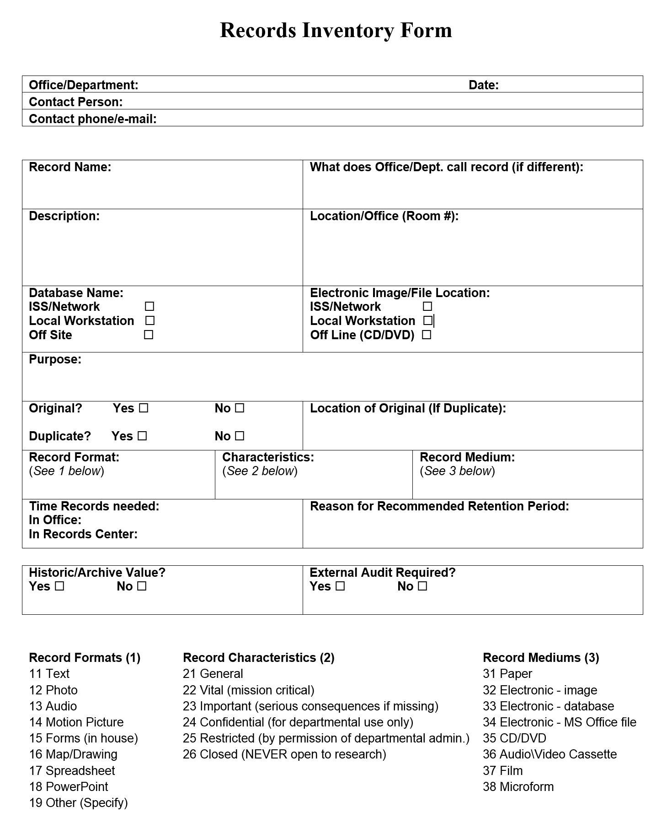
Sample Records Inventory Form

Slide 23
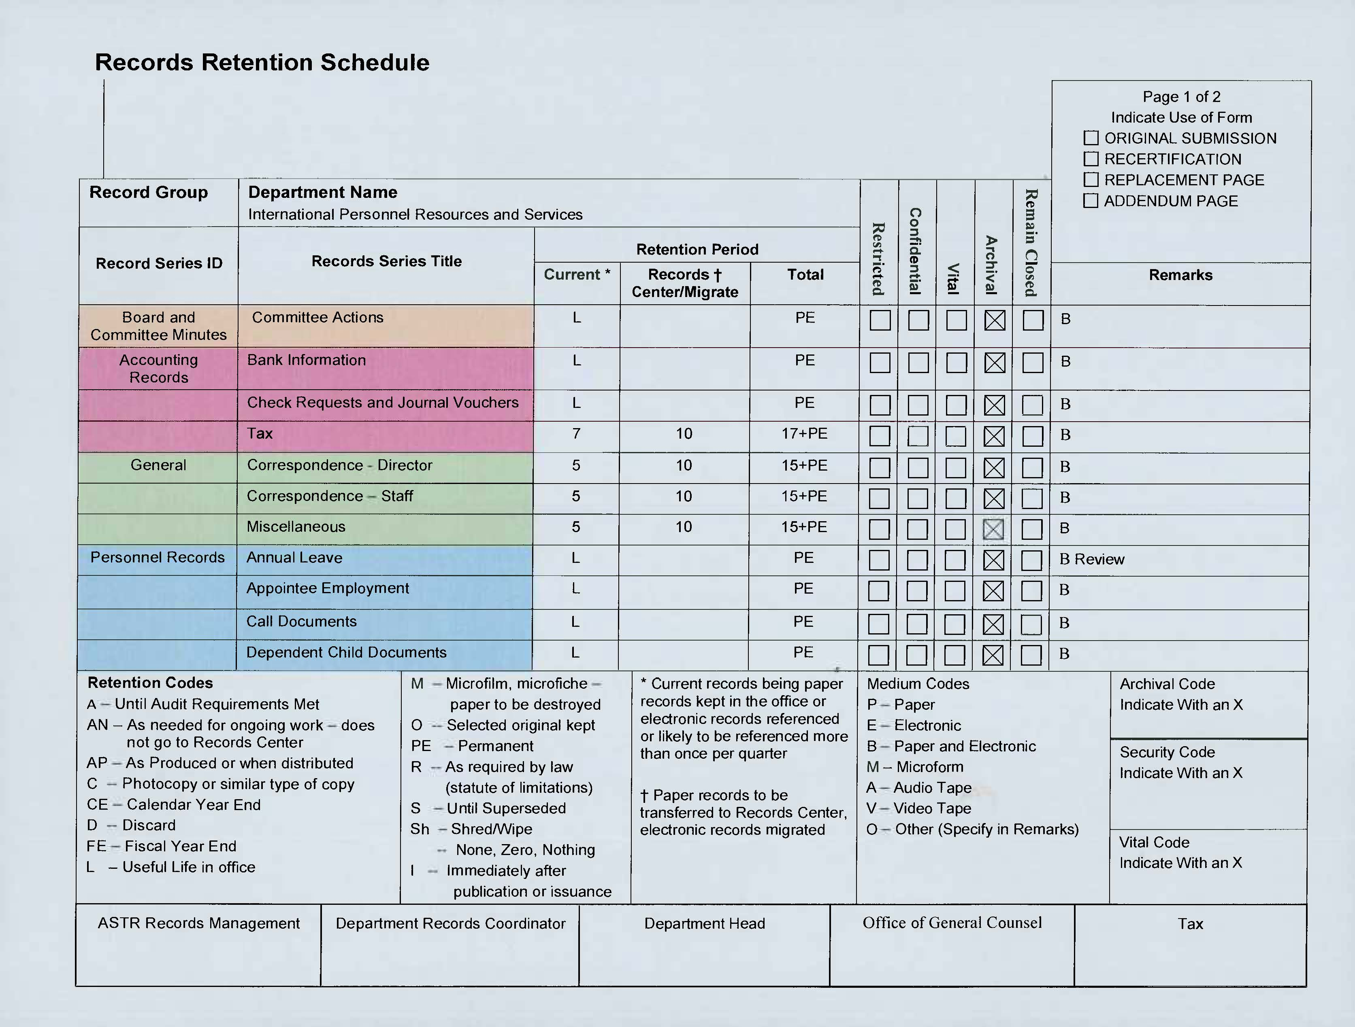

Slide 24
Record Retention Codes (1 of 2)
A Until Audit Requirements Met
AN As needed for ongoing work – does not go to RC
AP As produced or when distributed
C Photocopy or similar type copy
CE Calendar Year-End
D Discard
FE Fiscal Year-End
L Useful Life in the office, until no longer regularly used
OS Selected original kept

Slide 25
Record Retention Codes (2 of 2)
PE Permanent Preservation
R As required by law (statute of limitations)
S Until superseded or noncurrent
SCAN Scan to Digital
SH Shred/Wipe
-- None, Zero, Nothing
& Kept in secure and fireproof storage
# To be held until determined there’s no pour-over will connected within the trust
Nums Time period in years for retention of the various record types

Slide 26
Strategic Factors, Issues and Considerations in Drafting and Implementing a Retention Schedule
Retention Periods Must Comply with Applicable Laws
Review and Approval Needs to be Secured From All Stakeholders
Records Destruction Should be Done in the Normal Course of Business
Retention Schedule Should Not Be Developed to Improperly Destroy Evidence
Records Subject to Known Legal Process Must Be Preserved from Destruction

Slide 27
Concerns in Record Retention
* Retention Issues
* Creating a Retention Schedule
* Forms
* What to Toss
* What to Keep
* What to Archive
* How long to Keep it for

Slide 28
Data Gathering/Collection
A Pre-Existing Records Listing
In all but the smallest organizations, the records listing is almost certainly incomplete
A large percentage of records will be meaningless to you and to others
Unless the list has been carefully edited, it will be duplicative
A Records Inventory/Survey is Necessary to Determine What Records Exist
Personnel must be high-quality, trained and intelligent if results are to be useful
Keep in mind that this process only describes the state of the records system at a moment in time
A comprehensive inventory of electronic records may not be possible
Identifying the correct personnel to survey can be difficult
The response rate is often low and can be of poor quality
The survey form size and the number of questions on it must be limited
Interviews, and the problems associated with them, will definitely be encountered

Slide 29
What Information is Needed?
As complete a list of the kinds of records that your organization generates, receives, and uses as you can gather
Simply compiling a list of records or of kinds of records won’t permit you to construct a useful retention schedule. You need a useful description of the kind of information that it records
The length of time the record is to be is critical – and is the major common problem area because most people want to retain records longer than necessary:
They overestimate the real, ongoing value of their records
They assume that legal retention periods are longer than they actually are
They believe that they must be able to answer any inquiry, regardless of how unreasonable or how old the information that is requested
They think that the legal risks surrounding their records extend much further into the past than they really do
They are simply afraid or reluctant to dispose of old records
Their assumptions about risk are often based upon purely hypothetical, one-in-a-million scenarios

Slide 30
Structuring a Records Retention Schedule
Considerations
The complexity of the retention schedule will vary depending on the size and complexity of the organization
The larger the organization, the more complex the web of supporting services and departments needed to support its core operations
In order to really understand the records generated by an organization, understanding its operations, including both core and support operations, is essential
The Need for Structure
A reasonably complete records listing will be very long. The more complete and accurate the list, the worse the problem
An as-is listing will be in alphabetic or form number order, or no order at all, which is not very useful
Even a complete records listing will change over time. For this reason it’s not recommended to use a records listing as your retention schedule.

Slide 31
Questions so far?

Slide 32
Factors to Consider in Determining Retention Periods
Inasmuch as records are obviously created to support business processes, those records must be available, as much as possible, when they are needed by the staff that is performing the associated work activity. Eventually the record’s role in supporting the business process is completed, and if no other uses for the record are in the mix of retention factors, the record is eligible for destruction
Although most legal requirements affecting records retention impose minimum retention periods, with no penalty for retaining records longer, increasingly the situation is that legal requirements impose maximum retention periods, beyond which a record cannot legally be retained
In order to make sound risk-management records retention decisions, it’s necessary to have some understanding of the kinds of claims, lawsuits, investigations, and other activities that your organization is subject to. This information includes not only the nature and frequency of the actions themselves, but also the kind of records involved, the magnitude of the risk involved in monetary or other terms, and the time frames in which they occur

Slide 33
Developing Record Series
Records Within a Series Should be Closely Related
The individual record types within any series will have the same retention period. The records must be sufficiently similar that no issues will arise if they are destroyed after the same period of time
Records Series Must Be Meaningful
Records series must describe actual records. Not only must the series title and description be written with adequate clarity to allow people to accurately decide just what records you’re talking about; but also what the title and description refers to must correspond with actual, identifiable, and related records within your organization
Records Series Can Have Multiple Uses
By its nature, a retention schedule tells you something about your records. Large, broad records series, or”buckets” provide information about them at a very high level. A well-developed and reasonably granular retention schedule may serve as the basis for an indexing system or filing plan

Slide 34
What to Keep
Correspondence dealing with development or interpretation of policies, administrative problems, evaluations of personnel, projects, statistics, development of programs, final travel itinerary, complete set of original form letters
Minutes produced by your department or for which someone in your department is the chair
Reference or Case files created for specific purposes and used regularly during the development or solving of a problem or case
Topical files containing collected materials closely related to the work of your office
Materials published by your department including all audiovisual material (videos, photos, pod casts), one or more copies of reports and brochures, and certain financial reports that provide year-end or summary type information

Slide 35
What to Toss
Routine requests and acknowledgments for catalogs, brochures,or other stocked items
Routine requests and acknowledgments for your office’s services, and letters of appreciation,
Circular memos from other offices
Correspondence concerning travel planning
Non-SDA published or duplicated material
Temporary financial records – phone bills, purchase orders, receipts, check requests, cancelled checks, monthly financial statements

Slide 36
What to Archive
Think of the Archive as the corporate memory.
You would want to save records:
portraying beginnings, changes, endings
dealing with cases, events, problems, projects that reveal the purpose and function of the organization
documenting the relationship with other denominational organizations

Slide 37
Record Migration Path

Slide 38
Make sure that your record retention system works well for your organization

Slide 39
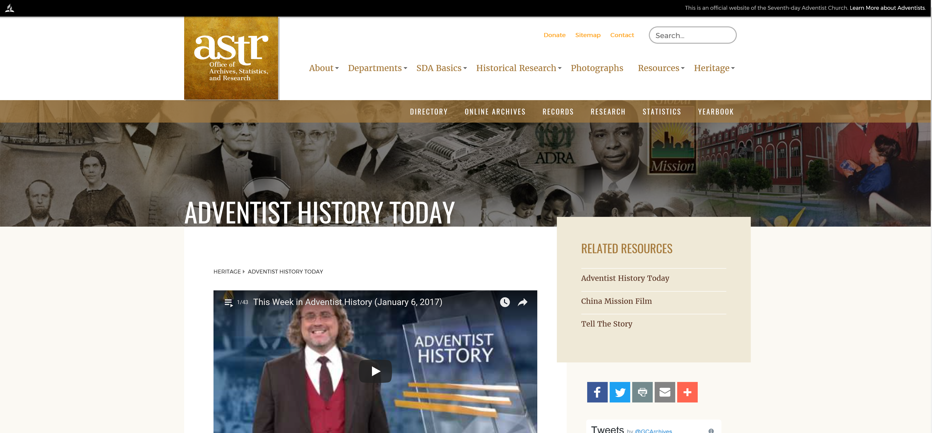
Archives Web Site www.adventistarchives.org

Slide 40
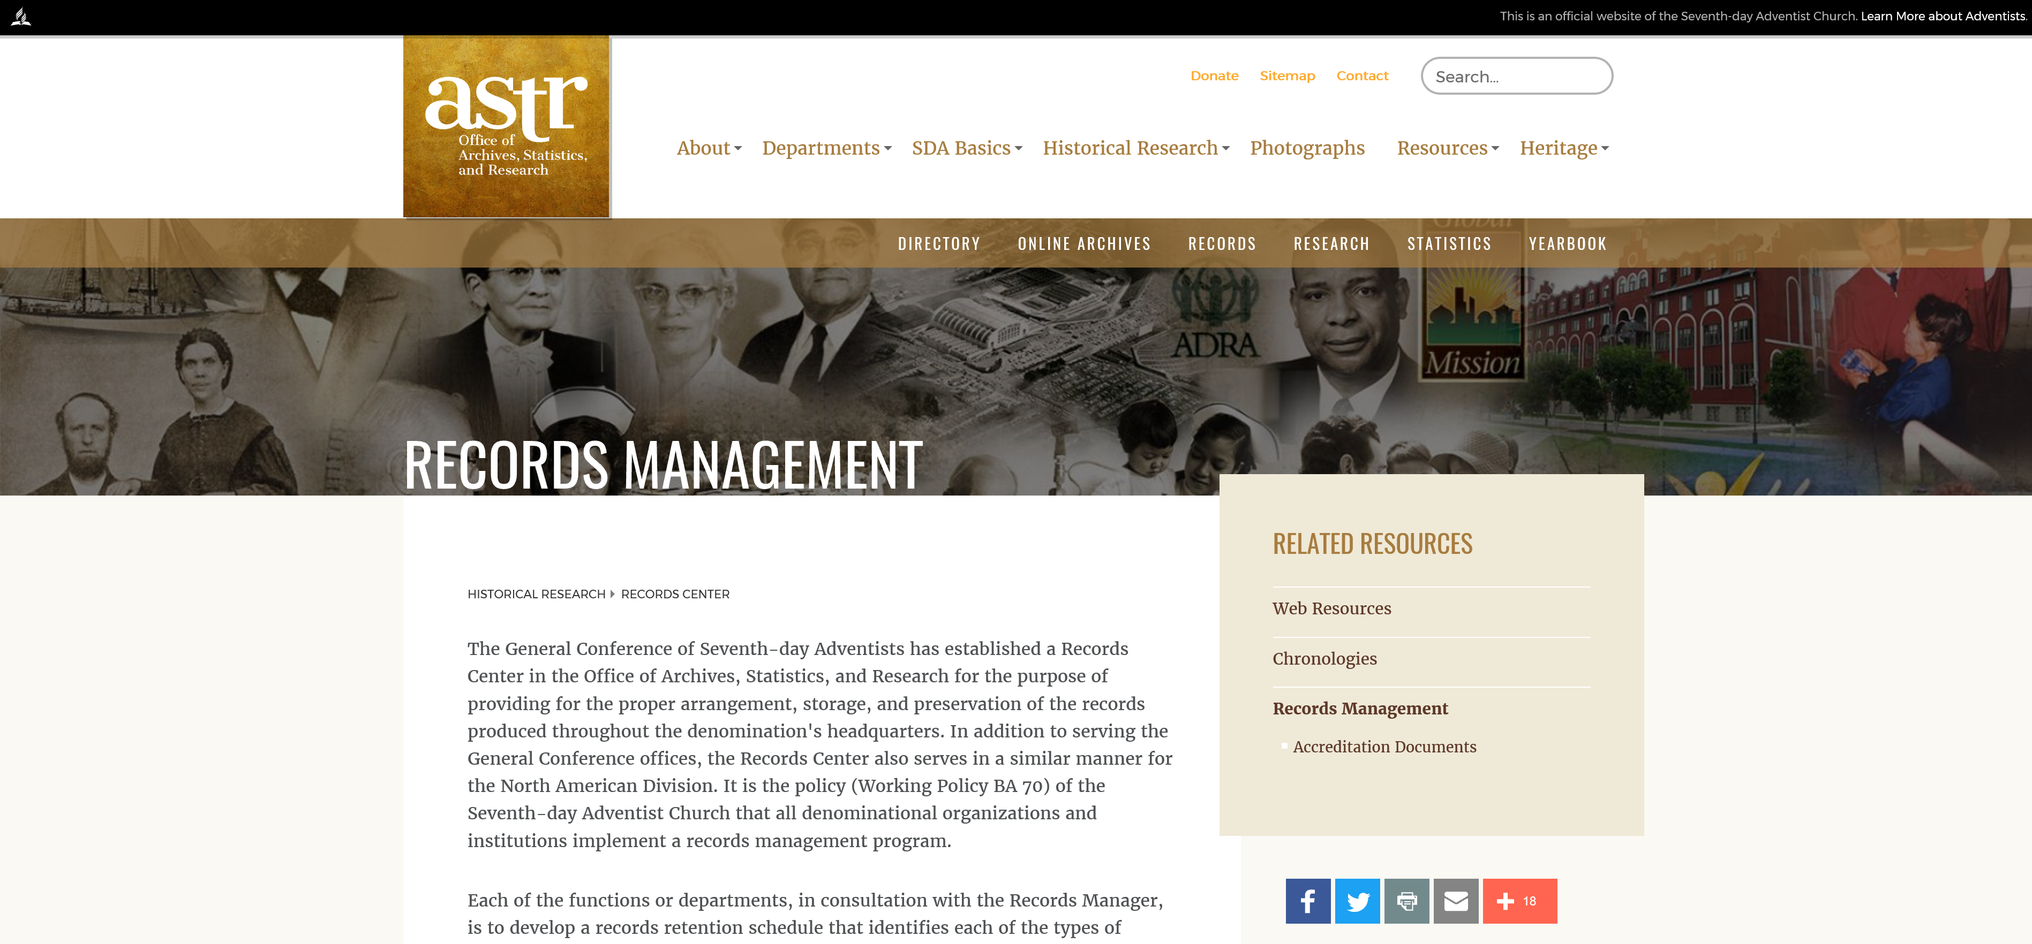
Records Center Web Page

Slide 41
Resources: Web Sites
General Conference
General Conference Web site: http://www.adventist.org
Archives Web page: http://www.adventistarchives.org/
Records Center Web page: http://www.adventistarchives.org/records- center#.U1_ImY0U-T8
Online Archives: http://documents.adventistarchives.org/default.aspx
Yearbook page: http://www.adventistyearbook.org/default.aspx?
Organizational Directory page: http://www.adventistdirectory.org/
Statistics page: http://www.adventiststatistics.org/
Archives & Records Management
ARMA International: http://www.arma.org
(Association of Records Managers & Administrators)
Society of American Archivists: http://www.archivists.org
National Archives and Records Administration (US): http://www.archives.gov
National Archives (Australia): http://www.naa.gov.au
UNESCO Archives Portal:
http://www.unesco.org/new/en/communication-and-information/portals-and-platforms/unesco-archives-portal/

Slide 42
Resources: Web Sites
Disaster Recovery
Disaster Recovery Journal: http://www.drj.com
Disaster Recovery World: http://www.disasterrecoveryworld.com
Disaster Recovery Guide: http://www.disaster-recovery-guide.com
Contingency Planning & Disaster Recovery: http://www.disasterplan.com
Electronic Records
Long Term Preservation: http://www.interpares.org/book/index.htm
Overview of Technical Approaches: http://www.clir.org/pubs/reports/pub107/thibodeau.html
Authenticity in a Digital Environment: http://www.clir.org/pubs/reports/pub92/contents.html
Preserving Authenticity: http://www.dlib.org/dlib/july00/eppard/07eppard.html

Slide 43
Lessons Learned – from a GC Record Retention Audit
Identify and contact the director of the department to be audited before moving forth
Let the director identify/delegate the audit process to a key individual within the department
Meet with the designated contact and keep him/her informed of every key step in the audit
Make everyone you meet along this process a friend; make sure you’re available when they need to speak with you; encourage and maintain plenty of dialogue

Slide 44
Establish timetables and make sure your contact(s) complies with each level
Stagger your departments’ timetables to ensure optimal use of your time, and of their time
Make your retention schedules as generic as possible
Ensure that the devised retention schedule is as transparent as possible.The measure of its success is the degree to which it is understood and followed
Keep your retention schedule current, and optimally effective, by conducting an audit annually – biannually at least

Slide 45
With records management and a retention schedule in place, your time in the office will be much more efficient

Slide 46
Final Questions ?

